Slide 1
Intro to cyber security
Mackenzie McClellan

Slide 2

Why does a website need security?
There is a successful hacker attack every 39 seconds
43% attacks target small businesses
44 records are stolen a seconds, about 3.8 million annually

Slide 3
95% of breaches are due to human error

Slide 4
How can this happen
Failing to update systems
Unsecure encryption of personal data
Using unsecure networks to send data
Built-in vulnerability to malicious websites

Slide 5
Big Corporate attacks
In most cases, a hacker can create ransomware, which will encrypt a company’s files under a different key so the business will not have access to it. With the files under their control, most hackers will hold it for ransom.

Slide 6
Small business attacks
A hacker targets smaller companies to gain access to personal data to be used on a much larger scale, like identity theft or fraudulent activity

Slide 7
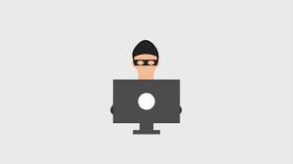
WHY SMALL BUSINESSES?
Small business usually have the lack of security infrastructure that bigger corporations do. This makes easy targets for attackers to steal personal data

Slide 8
88% of small business owners believe they are vulnerable to these attacks

Slide 9
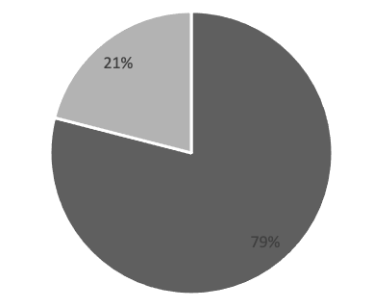
In a data security survey, 21% of respondents said they trust brands to keep their personal information secure

Slide 10
Small businesses need to build necessary security infrastructure to prevent these attacks in order to protect the company and customer's information

